Slide 1






Meet
iShop
An Inventory and Budget Tracking App for Groceries

Slide 2

Introduction
iShop: Grocery Tracking and Budgetong App
The Grocery Management Challenge highlights common difficulties many individuals encounter while handling their grocery inventory, such as forgetting essential items during shopping trips, which often leads to multiple store visits, and wasting food due to unnoticed expired perishables. Additionally, people frequently exceed their budgets without effective tracking, experience disorganization when shopping across multiple stores or occasions, and face challenges in coordinating grocery needs within households. iShop tackles these issues by offering a comprehensive grocery tracking solution that helps users maintain optimal inventory levels, minimize waste, and manage their grocery budgets efficiently.
02

Slide 3
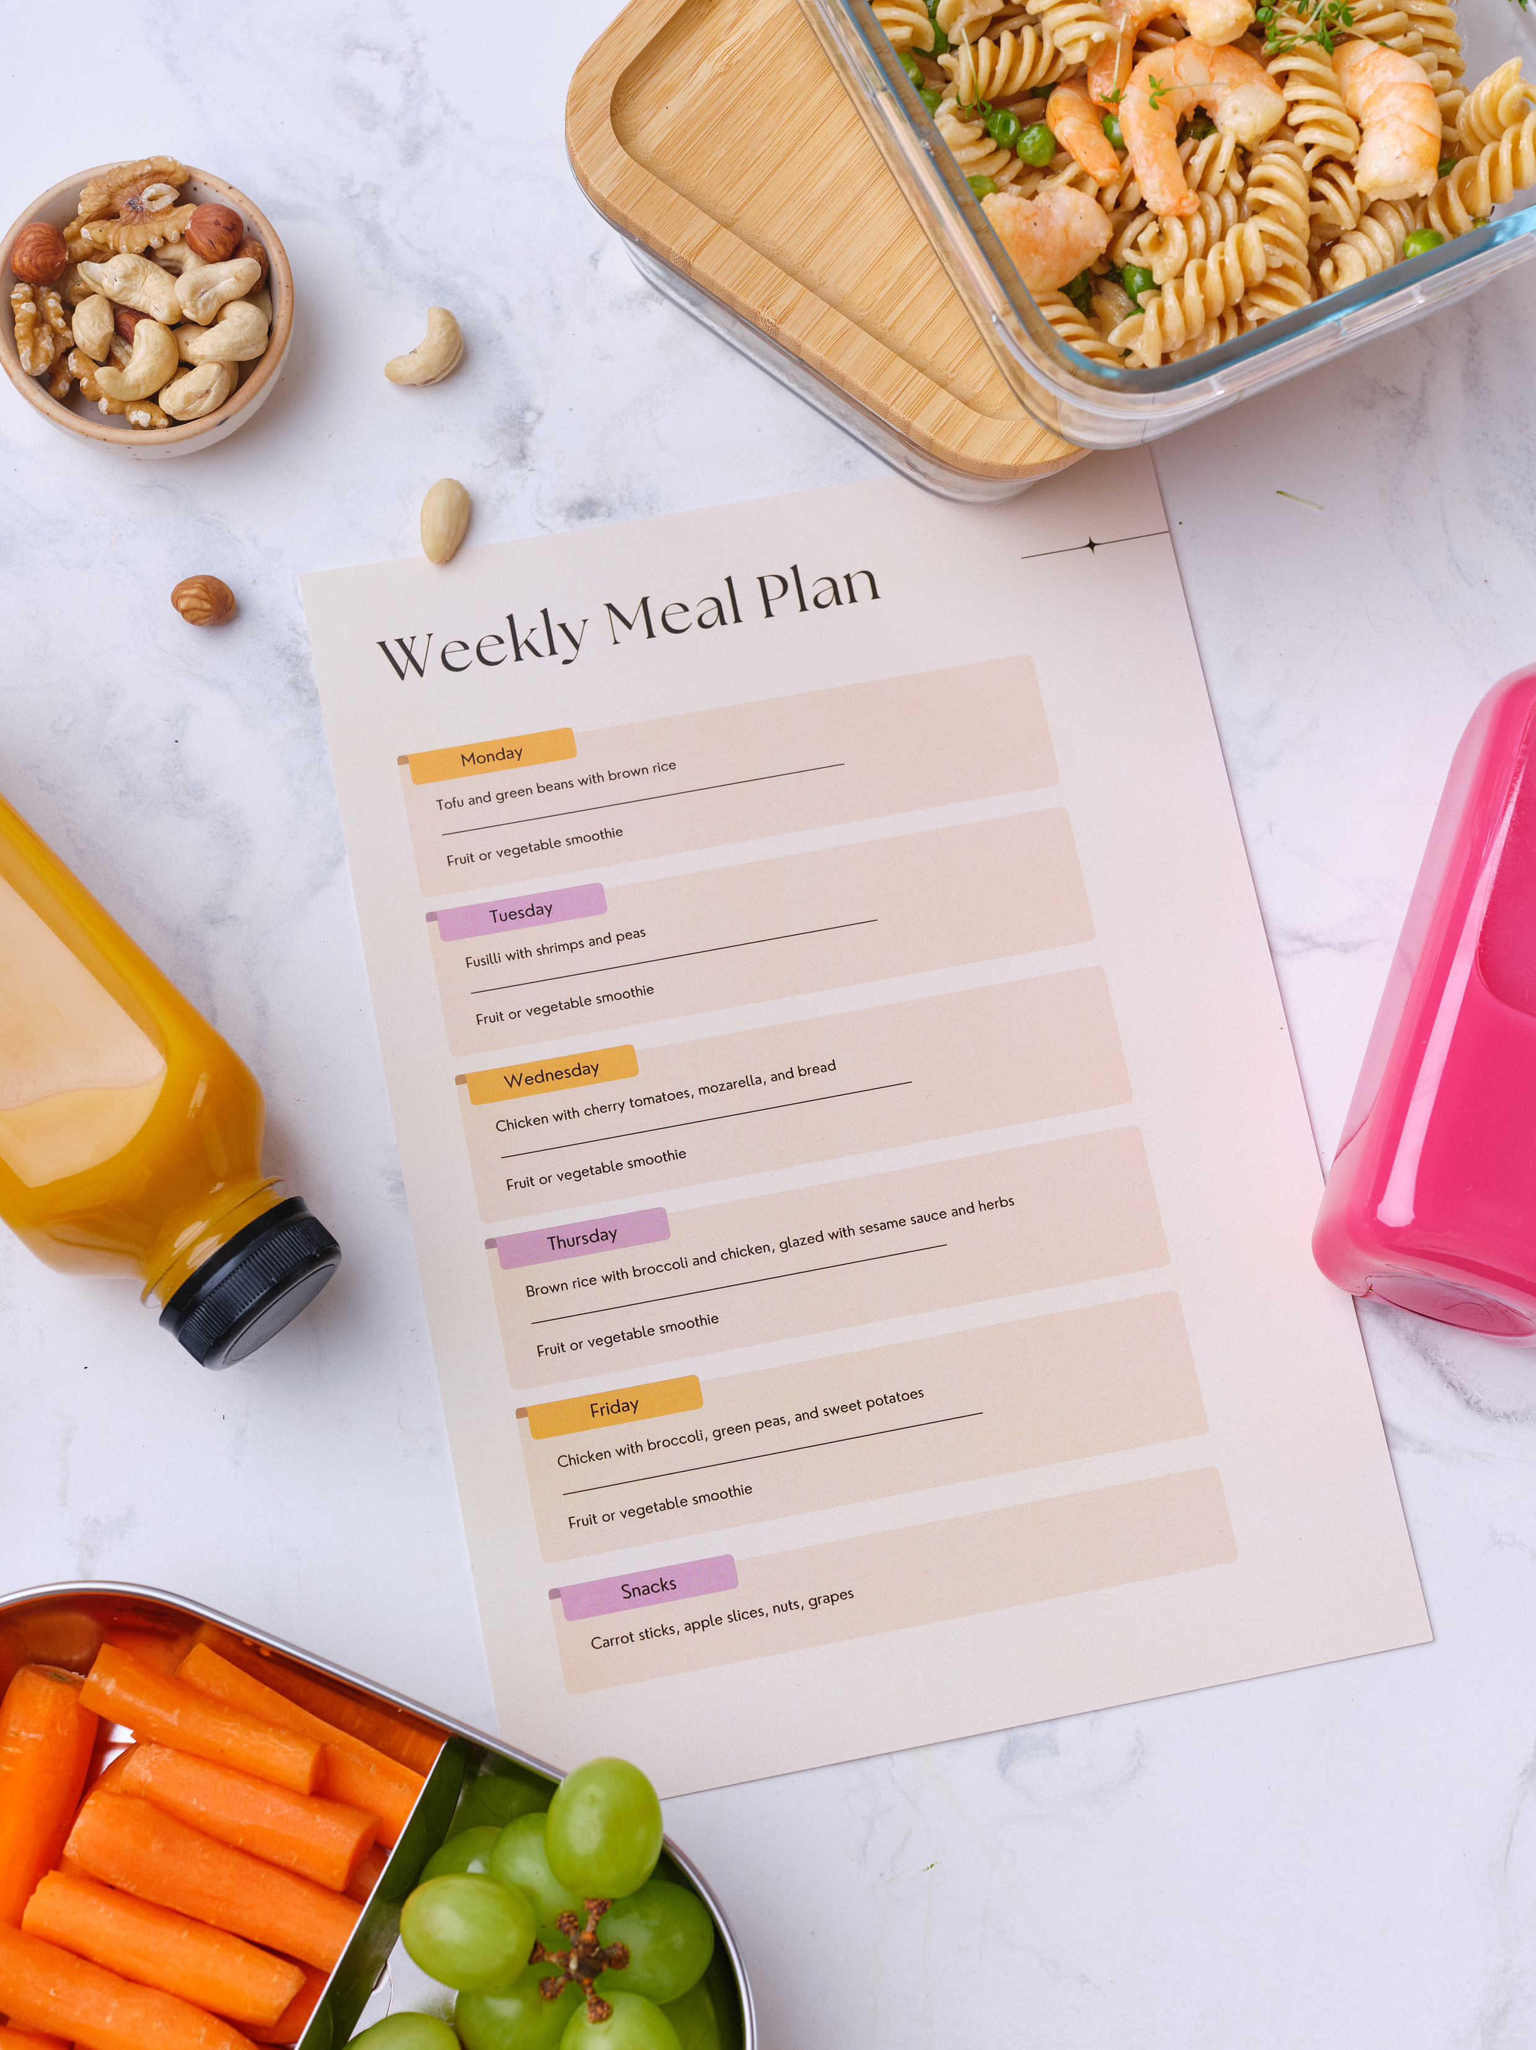
Design Approach & Solution Architecture
Phase 1: Core Functionality
A grocery list interface where users can:
Add and remove items easily
Mark items as "Available"
Local notifications that:
Alert users when items are running low
Help users stay ahead of restocking needs
iShop: Grocery Tracking and Budgetong App
Phase 2: Tracking Features
Expiration date alerts:
Notify users when perishable items are nearing expiry
Help reduce food waste and improve planning
03
Phase 3: Budget and List Management
Budget tracking:
Users can log item prices
Visualize and monitor grocery spending over time
Multiple list support:
Create and manage separate lists for different stores or occasions
Improve organization and provide greater flexibility

Slide 4
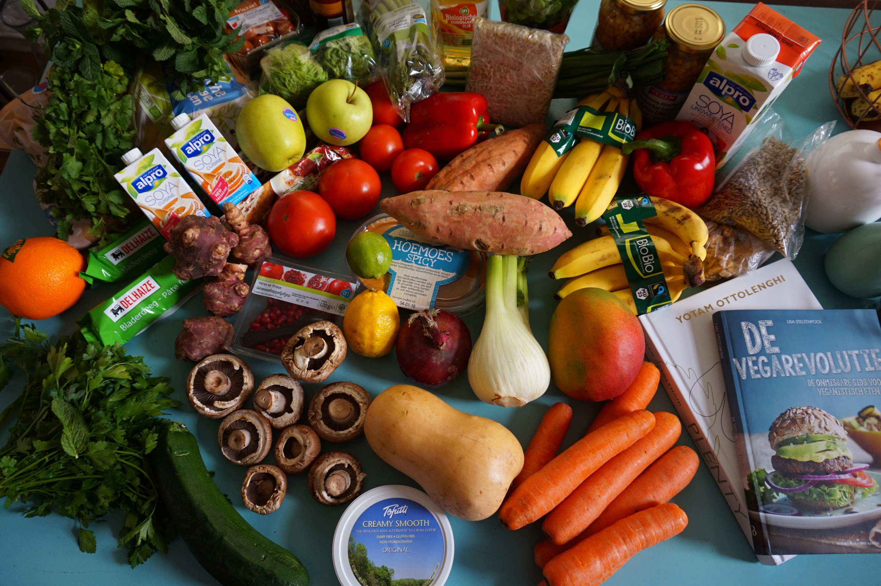
Design Approach & Solution Architecture
Phase 1: Core Functionality
iShop: Grocery Tracking and Budgetong App
Adopted a modular, component-based architecture prioritizing user experience while maintaining robust data management
Structured around core entities (GroceryList and GroceryItem) using SwiftUI's Environment pattern for state management
Designed components with clear responsibilities—AddItemView handles comprehensive item creation with attributes like quantity tracking and price formatting
Implemented a notification system that triggers alerts based on user-defined thresholds
Created flexible interfaces that adapt to individual shopping habits while maintaining intuitive navigation
04

Slide 5
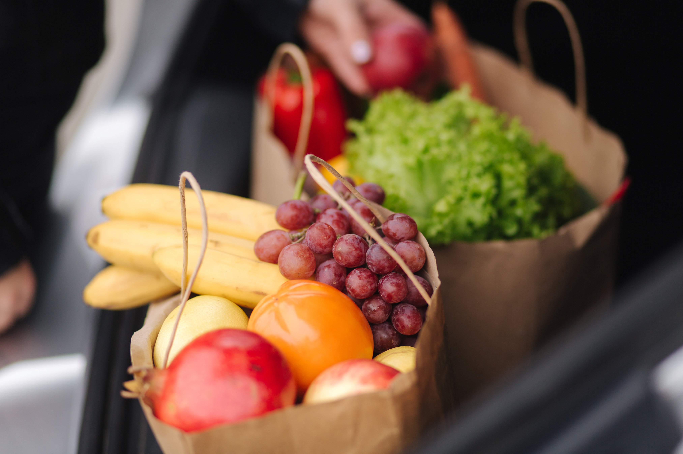
Design Approach & Solution Architecture
Phase 2: Tracking Features
Expiration Date Alerts:
Notifies users when food items are about to expire
Customizable notification timing before expiration date
Helps reduce household food waste
Simple calendar interface with date picker for users to set expiry dates
Integrated with device notification system for timely alerts
Batch Update View:
Allows users to update multiple grocery items at once
Features quick availability toggling with visual indicators
Includes quantity adjustment controls for efficient inventory management
Provides "Toggle All" function to mark all items available/unavailable
Shows item count for better inventory awareness
Sorts items alphabetically for easy navigation
Save changes to Core Data with single action
Clean, organized interface with intuitive controls
iShop: Grocery Tracking and Budgetong App
05

Slide 6
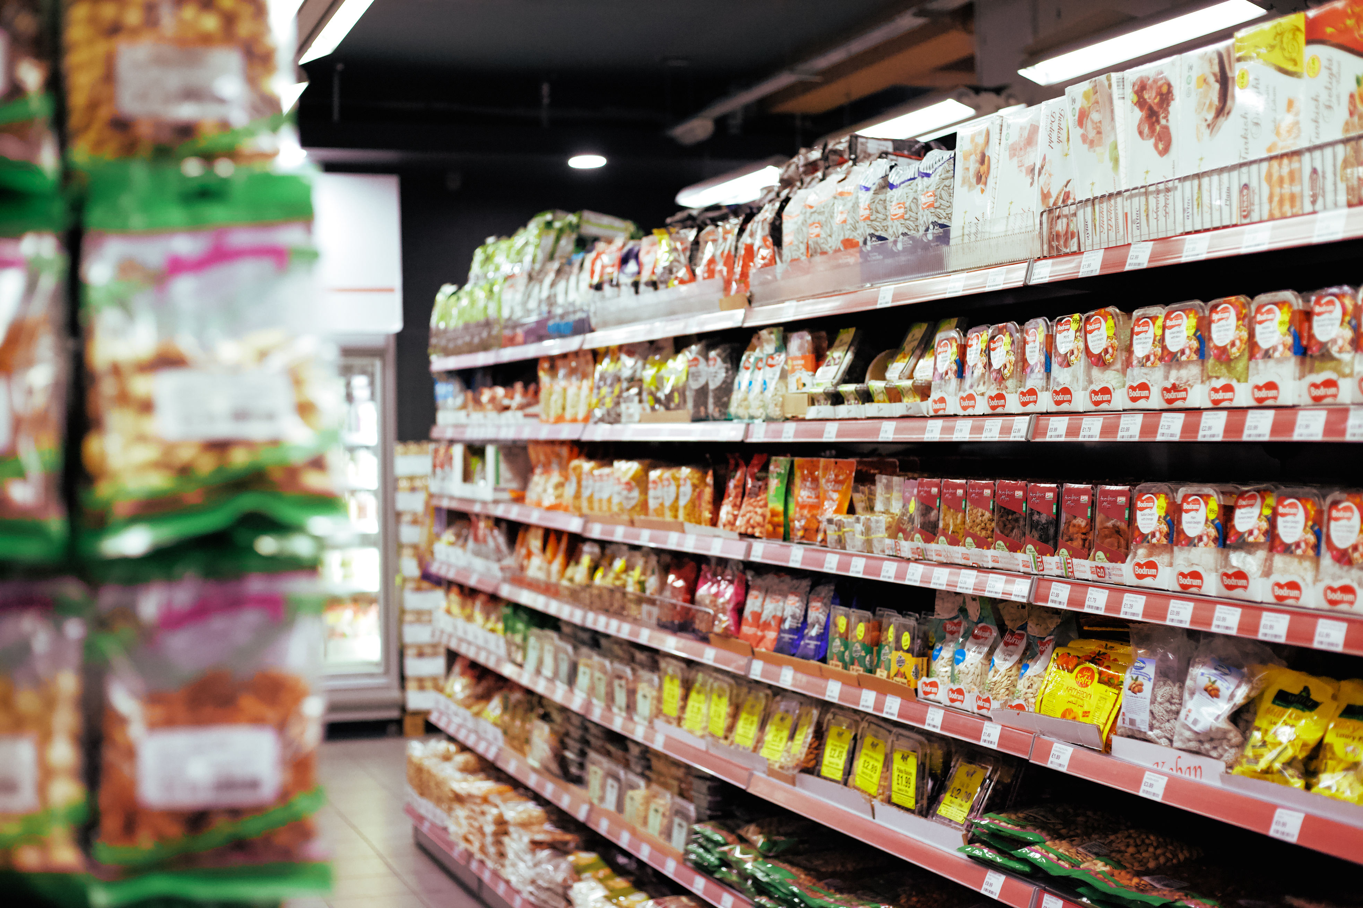
Design Approach & Solution Architecture
Phase 3: Budget and List Management
Budget Tracking:
Track spending with intuitive visual pie charts showing spending distribution
Monitor grocery expenses across customizable date ranges.
View detailed spending breakdowns categorized by grocery list names
Use the real-time refresh button to ensure you're seeing the latest budget data
Identify spending patterns with color-coded categories for quick visual analysis
Compare spending across different time periods to improve budget management
Multiple List Management:
Create and organize separate grocery lists for different stores, purposes, or household members
Navigate lists easily with smart date-based grouping (Today, Previous 7 Days, Previous 30 Days, Older)
Find specific lists instantly with the built-in search functionality
View essential list information at a glance including item counts and total spending
Update multiple items simultaneously with the efficient batch update system
Toggle item availability with a single tap in batch view
Sort lists chronologically to track your shopping history
Adjust item quantities directly from the batch update screen
iShop: Grocery Tracking and Budgetong App
06

Slide 7
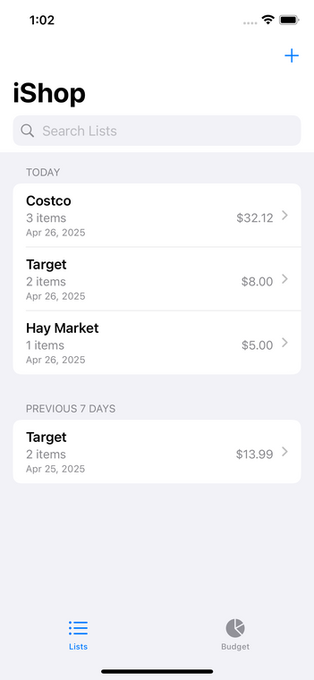
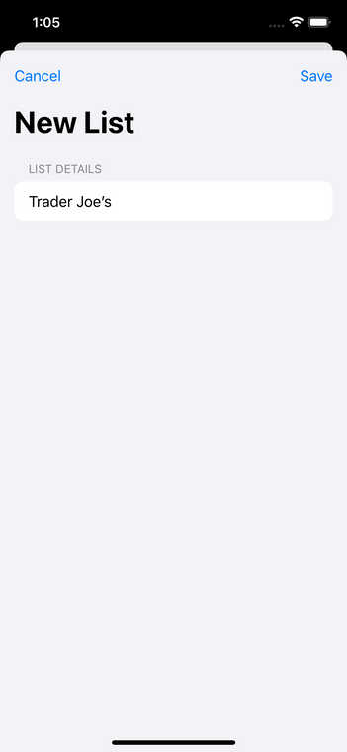
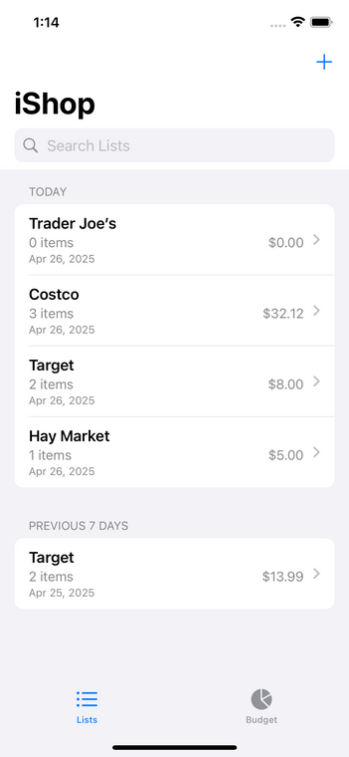
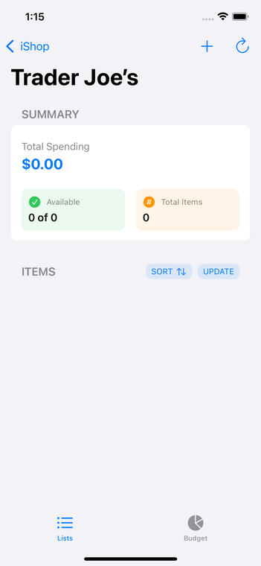
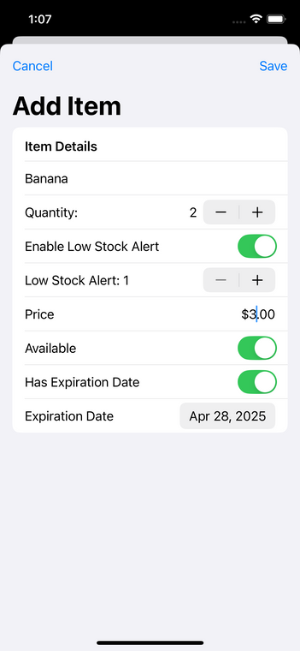
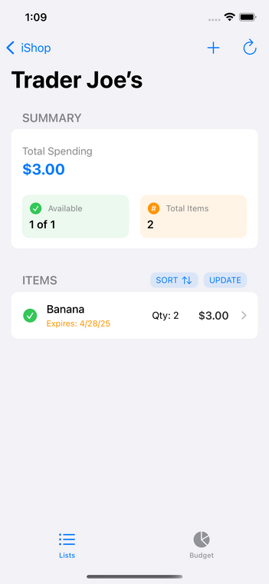
Product Demo
Flow
Click on Add Sign
2.Write List Name
3. Click on newly created list name
4. Click on Add Sign
5. Add required details and click save
6. Added List is displayed below
iShop: Grocery Tracking and Budgetong App
07

Slide 8
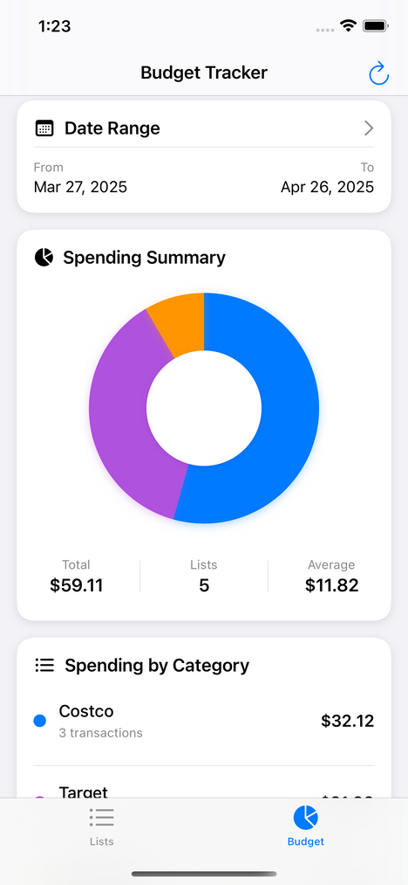
Budget Tracker
iShop: Grocery Tracking and Budgetong App
The iShop Budget Tracker features a donut chart visualization showing spending distribution across grocery categories, paired with a customizable date range selector for analysis. The interface displays both summary statistics (total, average, and list count) and detailed category breakdowns with transaction counts.
08

Slide 9

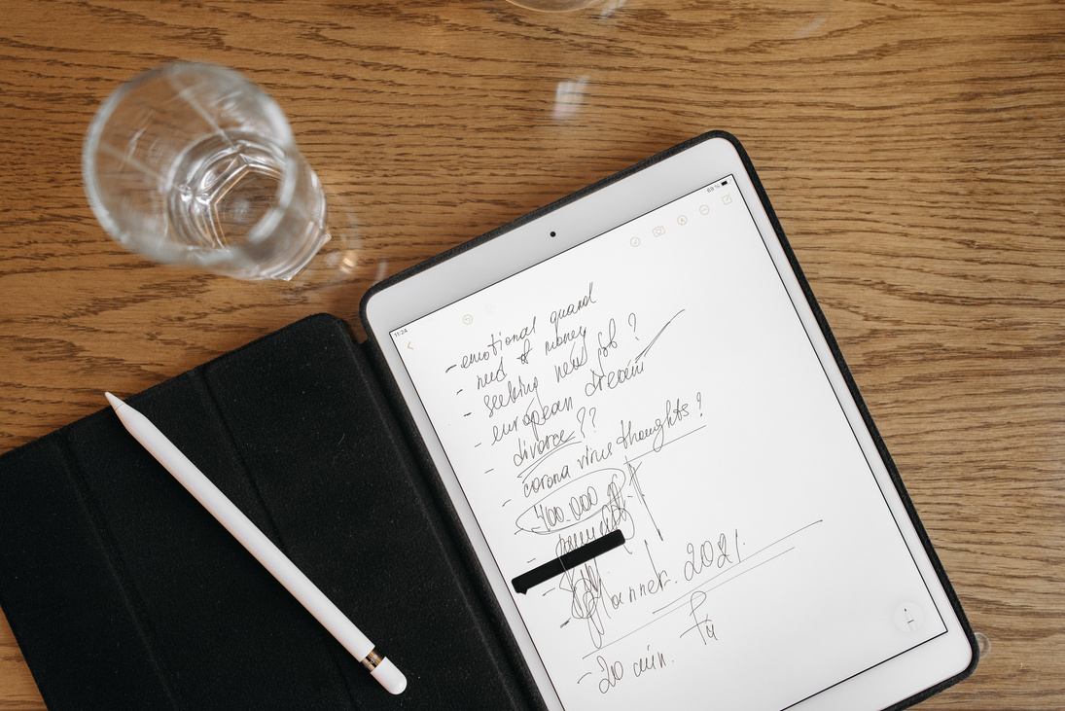

Future Enhancements
iShop: Grocery Tracking and Budgetong App
09
Bill Processing Through Camera
Enhanced Social Capabilities
Voice Assistant Integration
Real-time synchronization across multiple devices
Voice commands for adding, removing, and checking items
Automatic itemization of purchases from receipt images

